Slide 1
E-COMMERCE
Revenue
Analysis
A visual review of sales, profitability,
regional performance and customer patterns
Presented by Jaspreet Singh
POWER BI DASHBOARD PRESENTATION
01 / 09

Slide 2
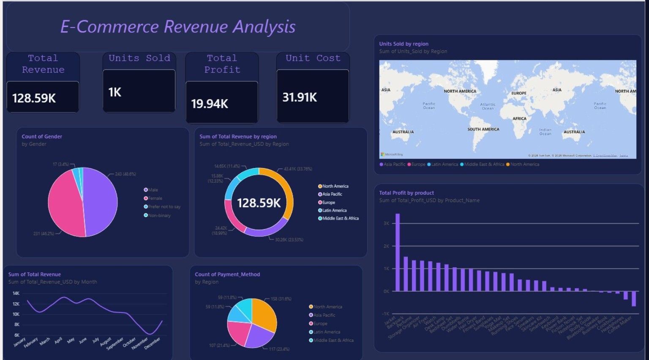
Dashboard at a Glance
The dashboard combines headline KPIs with regional, customer, product and monthly views.
Source: supplied Power BI dashboard screenshot
02 / 09

Slide 3
Key Performance Indicators
Headline metrics provide a fast snapshot of the store's performance.
TOTAL REVENUE
UNITS SOLD
TOTAL PROFIT
UNIT COST
128.59K
1K
19.94K
31.91K
Revenue shown in dashboard units
Approximately one thousand units
Profit contribution across products
Label/value as displayed in source
What these KPIs tell us
Revenue and profit should be read together to understand commercial performance.
Units sold gives a volume view, while cost metrics add context to profitability.
Use consistent currency, units and time periods before comparing or presenting results.
03 / 09

Slide 4
Regional Revenue Performance
The donut chart compares each region's contribution to total revenue.
Revenue mix by region
Key observations
North America
43.41K · 33.76%
North America is the largest contributor at about one-third of revenue.
Asia Pacific
30.26K · 23.53%
Europe
24.42K · 18.99%
Asia Pacific is the second-largest market and an important growth area.
Latin America
15.86K · 12.33%
Europe contributes just under one-fifth of total revenue.
Middle East & Africa
14.65K · 11.40%
The two smallest regions still represent nearly one-quarter combined.
04 / 09

Slide 5
Monthly Revenue Trend
The line chart highlights changes in revenue throughout the year.
Trend interpretation
Recommended follow-up
Revenue is strongest around spring and early summer, with peaks near April and June.
Compare each month's revenue with:
Units sold
The middle of the year shows a gradual decline after the early-year highs.
Discounts and promotions
October and November show a noticeable drop, followed by a December recovery.
Product availability
Investigate seasonal demand, promotions, stock availability and campaign timing.
Marketing spend
05 / 09

Slide 6
Product-Level Profitability
The bar chart ranks products by total profit and exposes loss-making items.
How to read the chart
Actions for the business
Products on the left generate the highest profit in the displayed ranking.
Protect inventory and visibility for consistently profitable products.
Profit drops across the product list, suggesting uneven contribution.
Review pricing, supplier costs and discount levels for low-margin items.
Bars below zero indicate products with negative profit.
Check negative-profit products for returns, data errors or excessive promotions.
Long product labels can be shortened or displayed horizontally for readability.
Use profit margin alongside total profit to avoid favouring only high-volume items.
06 / 09

Slide 7
Customer Demographics
The gender distribution chart summarizes the customer mix captured in the dataset.
Visible distribution
Interpretation and responsible use
The chart shows a broadly balanced split between male and female customers.
Female
231 · 46.2%
Male
243 · 48.6%
Keep inclusive response categories available in future surveys.
Prefer not to say
17 · 3.4%
Non-binary
Small share
Demographic data should inform service improvements, not stereotypes.
Cross-analyze with product category, region and repeat purchase behavior where appropriate.
07 / 09

Slide 8
Payment Patterns & Global Reach
Payment-method counts are shown by region, alongside a geographic view of units sold.
Payment method / region view
Map visual: use with care
The visual suggests transactions are spread across multiple regions.
A map is most useful when the location field is recognized as a geographic place.
North America appears to have the largest count in the displayed breakdown.
Use country, city or latitude/longitude fields rather than broad text labels where possible.
A count chart should be paired with payment-method names to clarify what customers use.
The map should display a measurable value, such as units sold or revenue, for each location.
Check whether the current chart is grouped by region or payment method; the field assignment should match the title.
Validate geocoding and remove ambiguous region names before drawing conclusions.
08 / 09

Slide 9
Conclusions & Next Steps
Turn dashboard observations into practical actions and a stronger reporting model.
Priority recommendations
Final takeaway
Investigate the late-year revenue decline and identify the causes of the December rebound.
Revenue is healthy at a headline level, but the dashboard's greatest value is in finding where performance differs by region, month and product.
Build a product action list for the highest-profit and negative-profit items.
Use the dashboard as a starting point for investigation—not as a substitute for validating the underlying data.
Compare revenue, profit, units and cost using aligned measures and definitions.
THANK YOU
Add slicers for date, region, product category and payment method.
09 / 09
Review data types, geographic fields, currency and KPI calculations before sharing.

